Slide 1
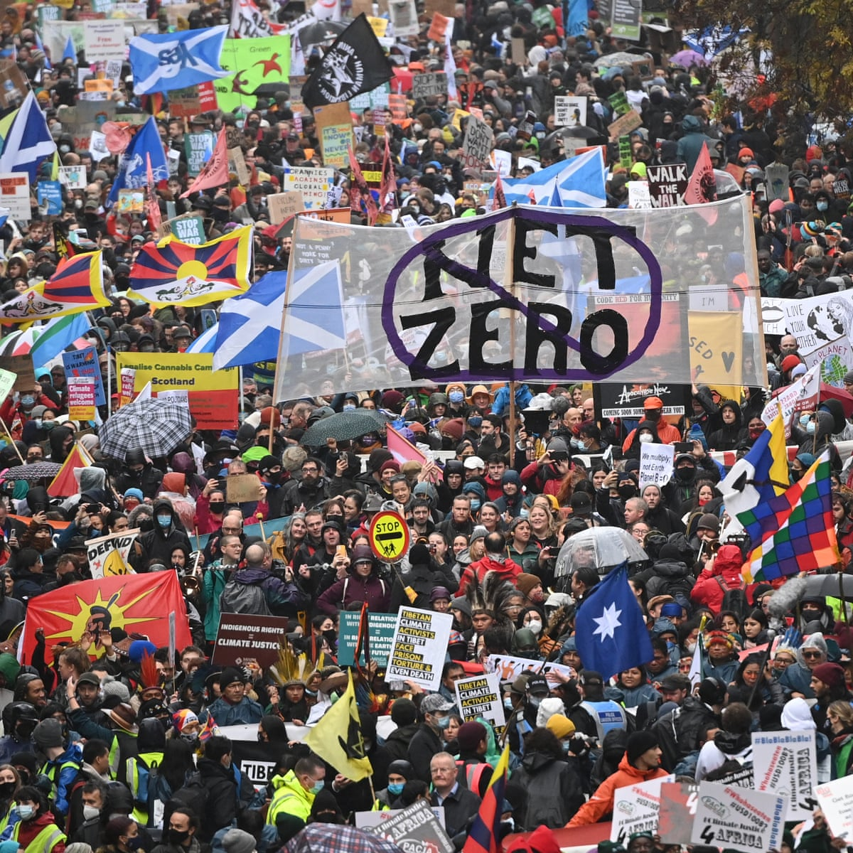
Norlington School and 6th Form March 1st/2nd/3rd
6.30 p.m.
This play contains adult themes and language
Suitable for Years 9-13

